Slide 1
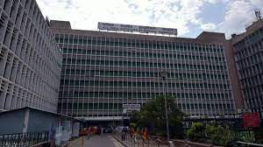
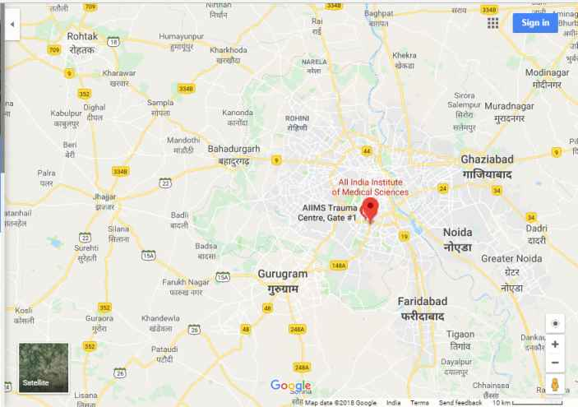
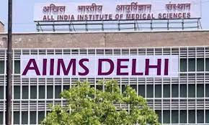
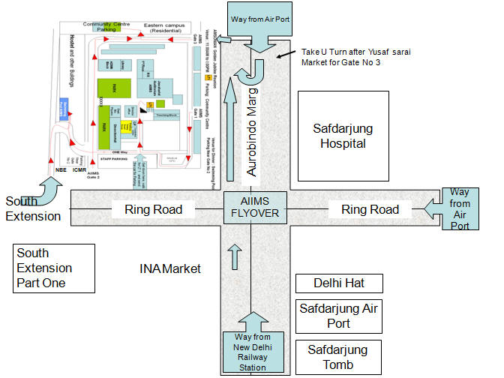
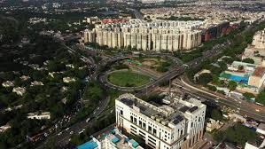
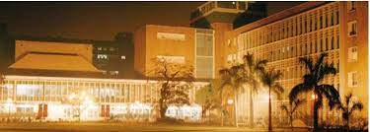
DESKTOP STUDY
ALL INSTITUTE OF MEDICAL SCIENCES (AIIMS) NEW DELHI, INDIA
INTRODUCTION
All India Institute of Medical Sciences, New Delhi, also known as AIIMS Delhi , is a globally acclaimed public medical research university and hospital based in New Delhi, India. The institute is governed by the AIIMS Act, 1956 and operates autonomously under the Ministry of health and Family welfare. AIIMS is the first Indian center to perform a successful cardiac transplant.
The hospital facilities cater about 1.5 millions and about 80000 in patients, and 100000 surgeries every year
No. of beds (main block) - 1162
Total beds - 2478
No. of doctors 800
Established year : 1956,
LOCATION
SITE AREA : 300acres
BUILDING HEIGHT : 38 meters (10 floors)
TYPE : Urban
FACILITIES
Highest Package Offered
Placement Cell
Placement Training
Internships
CTC Offered
Top Companies
Roles Offered
Average Package Offered
Percentage of Batch Placed
Recruiting Companies
Course Curriculum Design
Teaching Experience
Faculty Easily Approachable
Top Faculty
Quality education
Knowledge Sharing
Supportive Faculty
Industry Exposure
Medical Facility
Hostel Available
Canteen and cafeteria
Well equipped Class Rooms
Air Conditioned Campus
Library
Beautiful Campus
Top Infrastructure
Events Organized
Sports Festival
Scholarship Available
Fees Structure
Cultural Festival
Lowest Package Offered
Internship Stipend
Interview Process
Placement Process
Branch-wise Placements
Senior Batch Placements
Civil Eng. Placements
Consultancy Roles
Stipends
International Offers
Pedagogy
Research Projects
Student Interaction
Practical Focus in Curriculum
Student Faculty ratio
Senior Faculty Member
Personality Development
Latest Technology
Sports Facility

Slide 2
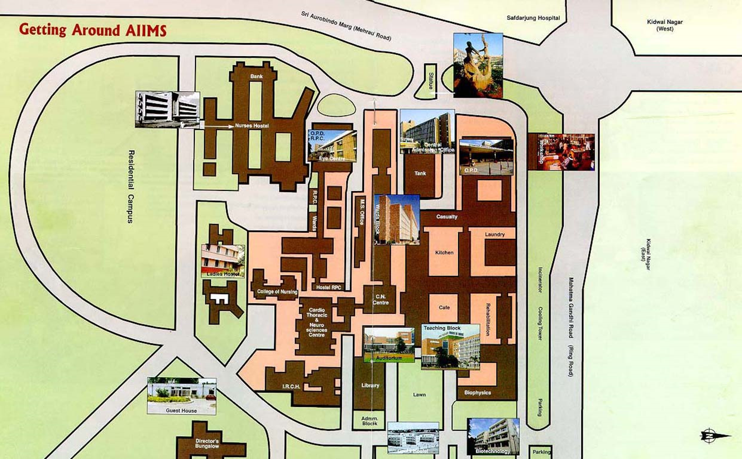

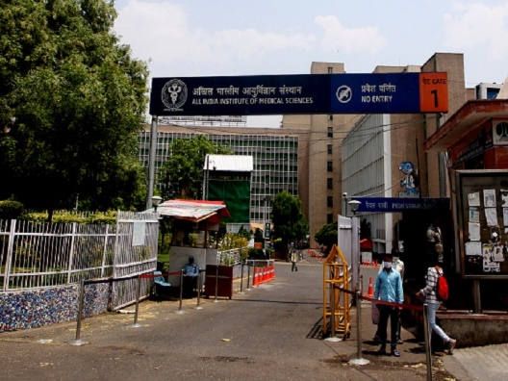
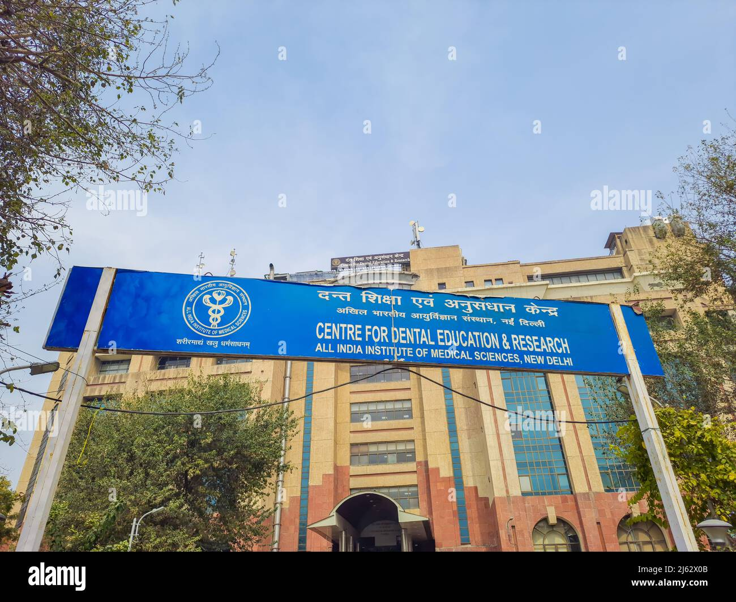
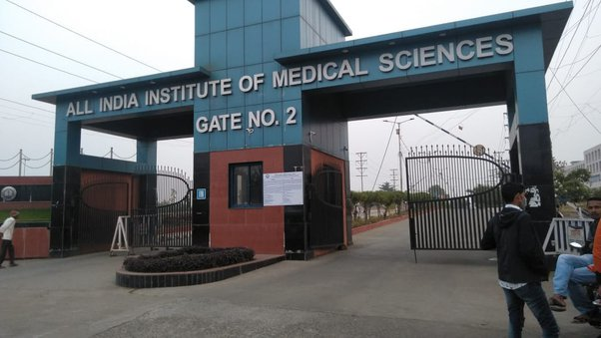
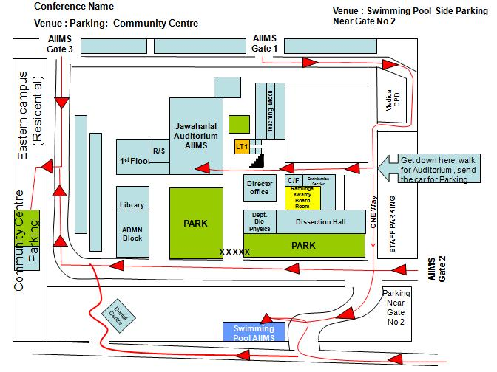
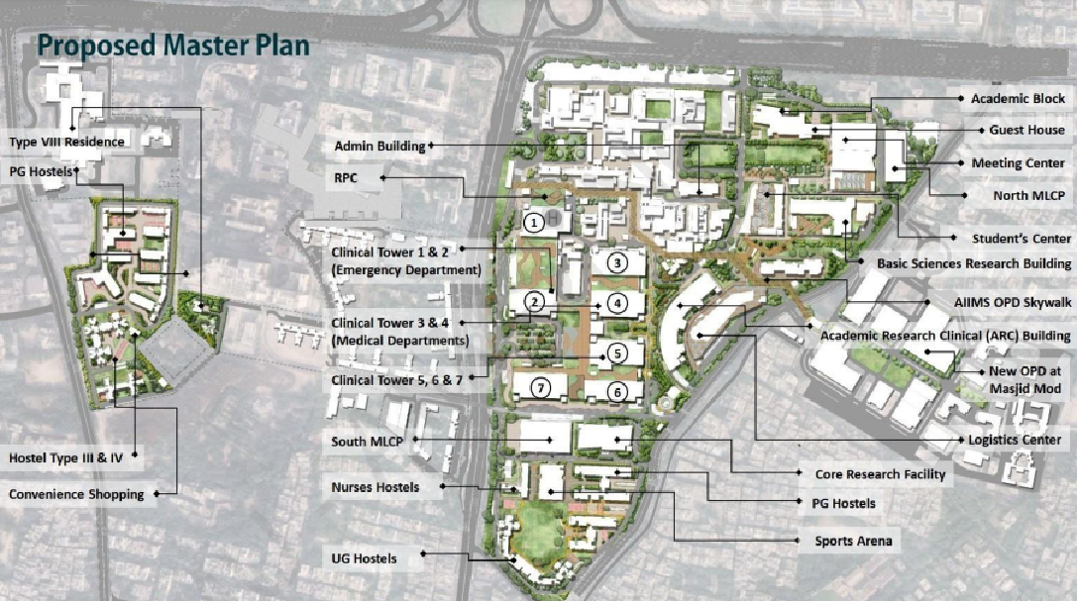
Departments
Anaesthesiology, Pain Medicine and Critical Care
Anatomy
Academic Section
Biochemistry
Biomedical Engineering
Biophysics
Biostatistics
Biotechnology
Cardiology
Cardiothoracic & Vascular Surgery (CTVS)
Centre for Community Medicine
College of Nursing
Dermatology & Venereology
Dietetics
Emergency Medicine
Endocrinology, Metabolism & Diabetes
Forensic Medicine and Toxicology
Finance Division
Geriatric Medicine
Gastroenterology and Human Nutrition
Gastrointestinal Surgery
Haematology
Hospital Administration
Laboratory Medicine
Medicine
Microbiology
Nephrology
Nuclear Medicine
Nuclear Magnetic Resonance
Nursing Department
Obstetrics and Gynaecology
Orthopaedics
Otorhinolaryngology
Pediatrics
Paediatric Surgery
Pathology
Pharmacology
Physiology
Physical Medicine & Rehabilitation
Plastic Surgery
Psychiatry
Pulmonary,Critical Care and Sleep Medicine
Radio Diagnosis
Reproductive Biology
Research Section
Rheumatology
Surgical Disciplines
Transplant Immunology & Immunogenetics
Blood Centre,Main Hospital Department of Transfusion Medicine
Urology
ENTRY / EXITS
Gate 1 and Gate 3 will open at Aurbindo marg. Both of the gates have entry and exit.
Gate 2 will open on ring road and it will only have a exit.
Gate 4 will be shifted to south extension and has both entry and exit.
Gate 5 is near Doctor’s hostel near the parking area and will have entry and a exit ; Also is strictly restricted to staff / faculty / residents having identity card.
ZONING
FUNCTIONS
Undergraduate and post graduate teaching in medical and related physical biological sciences.
Nursing and Dental education.
Innovations in education.
Producing medical teachers for the country.
Research in medical and related sciences.
Healthcare: preventive, promotive , curative ; primary , secondary , tertiary.
Community based teaching and reaserch.

